Slide 1
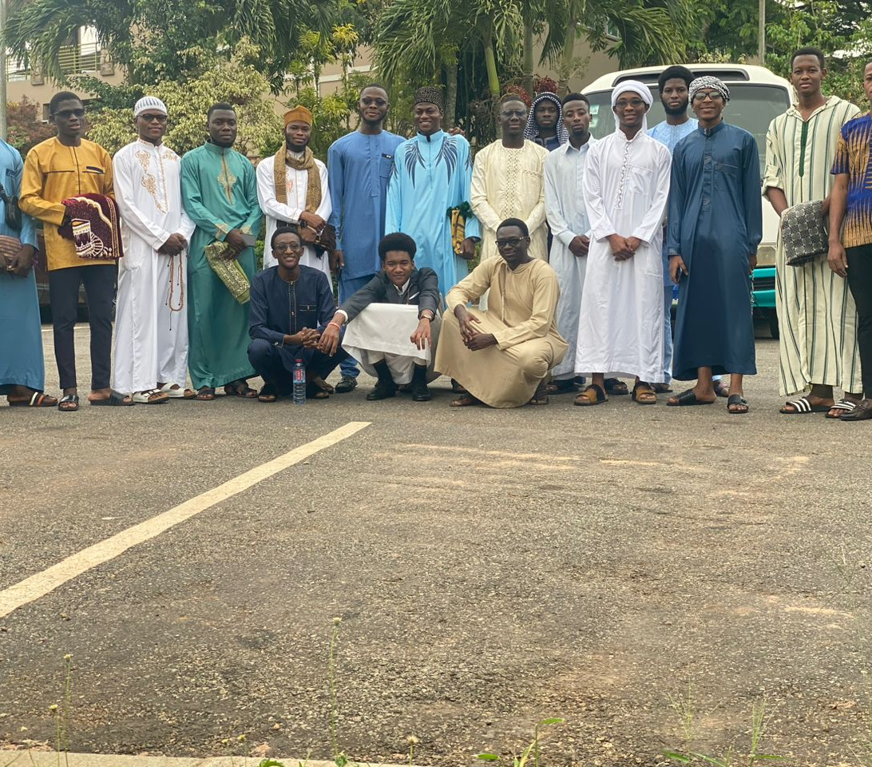
Ashesi Muslim Community
Handing Over Ceremony

Slide 2
Agenda for Today's:
Opening Prayers
Review of the Past Board
Presentation of the New Board
Short word by our New Board
Q&A Session
Vote of Thanks and Closing Prayer.

Slide 3
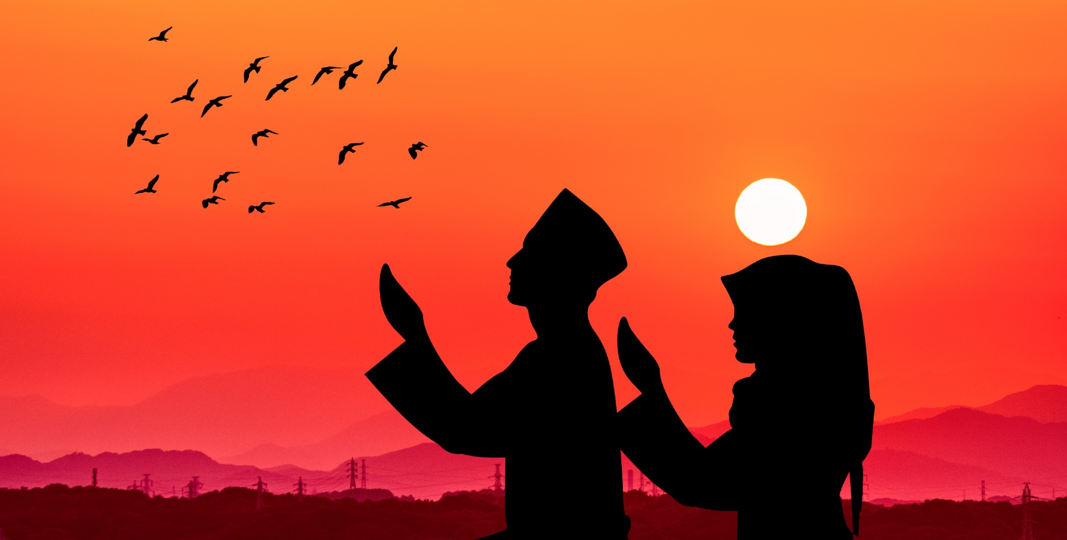
Opening Prayer
(Dua'a).

Slide 4
The Old Executive Council
President – Abdul-Karim Ngoliba
Vice president – Alhassan Tawfiq Ahmed
General Secretary – Adim Anjouj.
Imaams – Mubashir Kalidu and Adim Anjouj
Financial secretary – Hafiz Adjei
Ladies Commissioner – Mansura Mahabub Lawal
Organizers – Ousman Camara and Issifu Fati
Muazzin – Ousman Sadick and Ayub
P.R.O – Furkan Alhassan

Slide 5
The New Executive Council
President – Faisal Alidu
Vice president – Abdul Rauf Mukaila
General Secretary – Issah Alhassan
Imaams – Furkan Alhassan & Afa Musah
Financial secretary – Morro Suleyman
Ladies Commissioner – Mansura Mahabub Lawal
Organizers – Ismael Adams & Habiba Jingunaah
Muazzin – Abubakri & Abdul Hakim

Slide 6
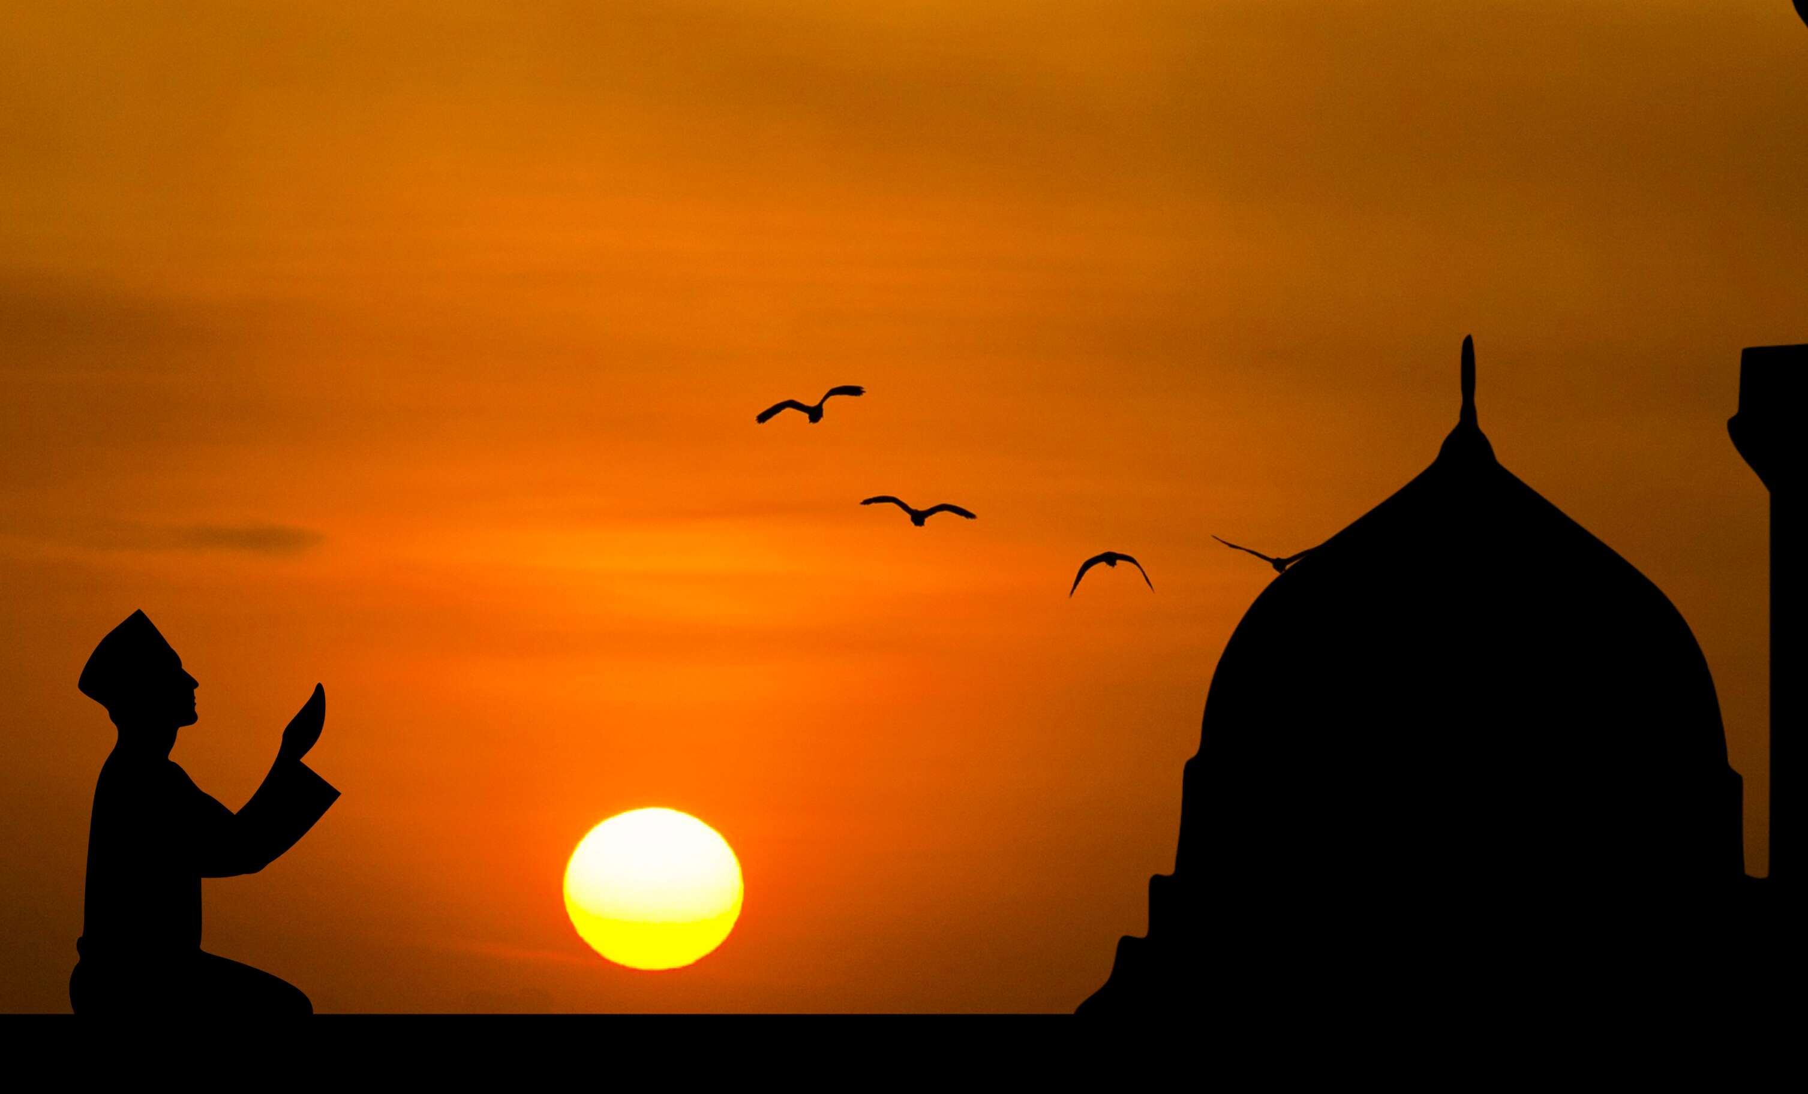
Conclusion
Closing Prayer (Dua'a).

Slide 7

Questions
Thank you/ Merci Beaucoup!

